Slide 1
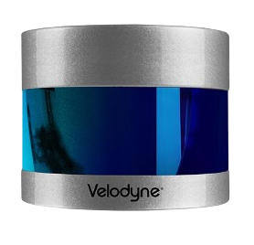

Velodyne VLP32C
Description
Velodyne VLP32C is a 3D LiDAR.
Velodyne LiDAR’s ULTRA Puck VLP-32C is an advanced sensor that combines long-range performance with 0.33-degree vertical resolution in a compact form factor.
The VLP-32C includes distance and calibrated reflectivity measurements at all rotational angles.
Specifications
Operating Voltage - 10.5V to 18V (Default 5V)
Detection Range - 200m
Scanning Angle - 360 deg
Scanning Frequency - 5 to 20 Hz
Applications
Autonomous Vehicles
Robotics
Industrial Automation
Security and Surveillance
Official Website : https://icave2.cse.buffalo.edu/resources/sensor-modeling/VLP32CManual.pdf
Notes:
Keep Market Segments Change Names
Electrification >>>> Powertrain

